Slide 1



CHATBOT
FOR
HEALTHCARE APPOINTMENT
METHUN S.M
422521104022
University College Of Engineering Villupuram.

Slide 2

Overview
Problem Statement
Proposed Solution
System Development Approach
Algorithm & Development
Result
Conclusion
References

Slide 3

PROBLEM STATEMENT
Inefficient appointment scheduling and assistance processes in healthcare, leading to delays and frustration for both patients and healthcare providers..
WHO ARE THE END USERS ?
The end users of the healthcare appointment scheduling system project include patients, healthcare providers, administrative staff, hospital or clinic management, IT support staff, system administrators, and patients' families or caregivers.

Slide 4

PROPOSED SOLUTION
Development of a healthcare chatbot to automate appointment scheduling, management, and assistance tasks, aiming to improve efficiency and enhance the patient experience.

Slide 5

SYSTEM DEVELOPMENT APPROACH
DATA COLLECTION
PREPROCESSING
MODEL ARCHITECTURE
DESIGN
TRAINING
We gather a diverse range of intents, user queries, and responses related to healthcare appointments, ensuring a comprehensive understanding of user needs..
Through techniques like tokenization, sequence padding, and one-hot encoding, we refine the data, preparing it for model training with precision and clarity.
With our model primed and ready, we embark on the training journey, fine-tuning its parameters to perfection, ensuring it emerges as a robust solution for healthcare appointment management.
Our architecture elegantly combines Embedding, LSTM, and Dense layers, crafting a framework that excels in performance and efficiency.

Slide 6

ALGORITHM & DEVELOPMENT
01
02
03
04
Advanced NLP Techniques
Optimized Training Approach
Empowering User Interaction
Performance Optimization
Leveraging cutting-edge methods such as Tokenization, sequence padding, and LSTM-based classification to enhance the chatbot's comprehension of user queries.
Employing the Adam optimizer and categorical cross-entropy loss function to fine-tune the model's parameters and maximize classification performance.
Equipping the chatbot with sophisticated NLP capabilities enables seamless interaction with users, ensuring accurate understanding and appropriate responses..
Through meticulous training and utilization of advanced techniques, the model achieves heightened performance, elevating the chatbot's efficacy in real-world scenarios.

Slide 7

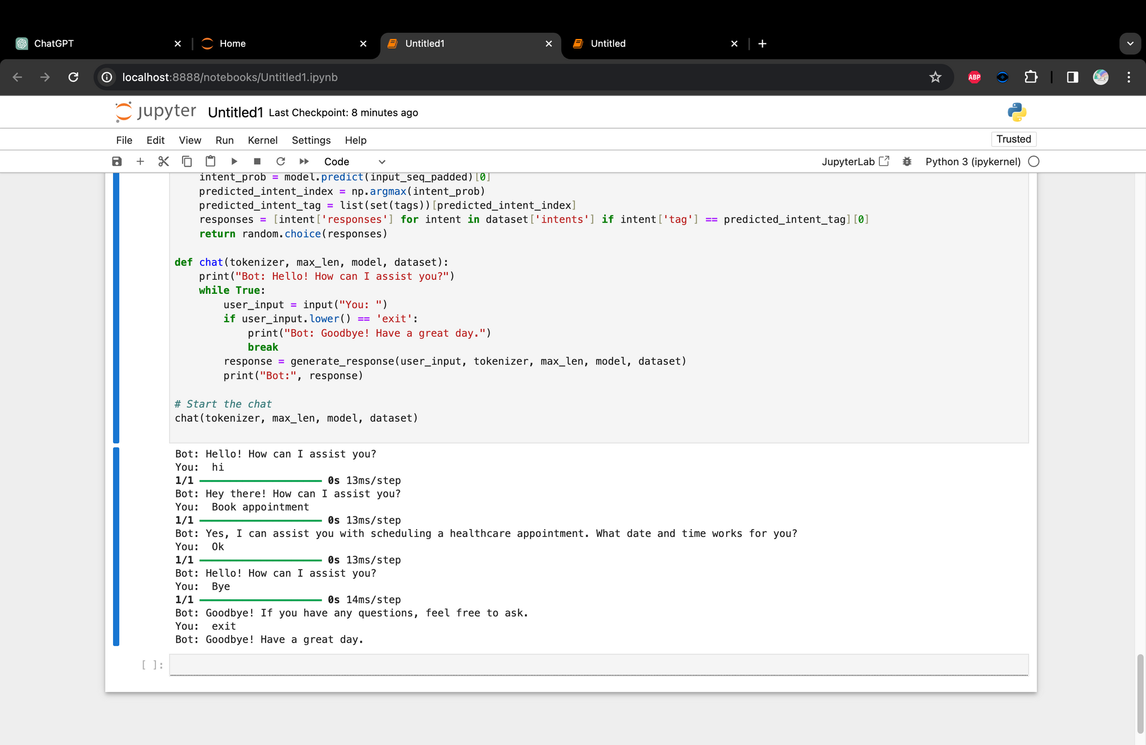
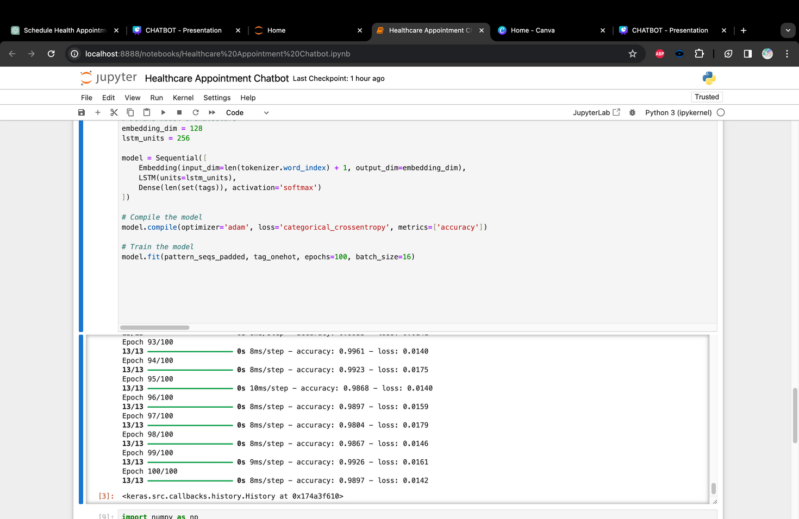
RESULT
The chatbot model demonstrates high accuracy and effectiveness in categorizing user queries, leading to streamlined appointment processes and improved patient satisfaction.

Slide 8
CONCLUSION
The implementation of the healthcare chatbot offers a transformative solution, revolutionizing appointment management and assistance in healthcare delivery.

Slide 9
REFERENCES
https://www.tensorflow.org
https://keras.io
https://www.ibm.com/topics/neural-networks
https://www.ibm.com/blog/chatbot-examples-a-beginners-guide/

